Slide 1


FIFA 21
Presentation
FROM EXPATIATE TO A SIMPLIFIED ANALYSIS
BY NICOLE & SWAPNALI

Slide 2
Agenda
01
About FIFA
02
Problem Statement
03
Insights
04
Model Building
05
Regression Summary

Slide 3


FIFA 21
FIFA is one of the most played console games in the world. Released on the 9th of October 2020, FIFA 21 in particular was released as the 28th installment of the FIFA series for Microsoft Windows, Nintendo Switch, Playstation 4 & Xbox One.

Slide 4
Process
Data Cleaning
Data preprocessing
Objective/Desired Outcomes
EDA
Modelling

Slide 5
Problem Statement & Desired Outcomes
EDA: Highlight the top players for their outstanding performances in FIFA 21.
Countries with the best players
Highest Paid players
Foot preference
Best passes & Best Defenders
Strongest & Fastest players

Slide 6
Regression Objective
Generate a model using performance based attributes to predict the overall value (‘OVA’) of the player
Independent Variables:
'name','value','wage','short_passing','dribbling','long_passing','acceleration',
'sprint_speed','shot_power','long_shots','positioning','vision','penalties','ova','defending',
'goalkeeping','phy','volleys','crossing','finishing','fk_accuracy','curve',"bp"
Dependent Variable: ‘OVA’
Source: Source:https://fifauteam.com/fifa-21-attributes-guide/

Slide 7
Data Cleaning and Preprocessing
Points of Highlight
Column selection
Performance based attributes selected based on affinity with target variable ‘OVA’ - overall value
Mean chosen instead of median for null values based on graphical distribution
Source:https://fifauteam.com/fifa-21-attributes-guide/
Outliers not removed
Removing outliers in this dataset would mean deleting outstanding individuals (i.e Messi) with extraordinary attributes & high wages
No transformation was performed on bimodal variables
Bimodal variables = two distinct peaks in distribution.
As the ‘defending’ and ‘goalkeeping’ variables are predictors, transforming them will not contribute anything to regression process
Source: https://stats.stackexchange.com/questions/124059/how-to-transform-continuous-data-with-extreme-bimodal-distribution

Slide 8
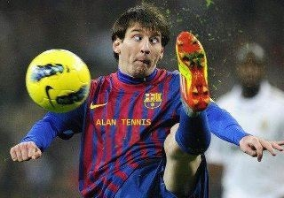

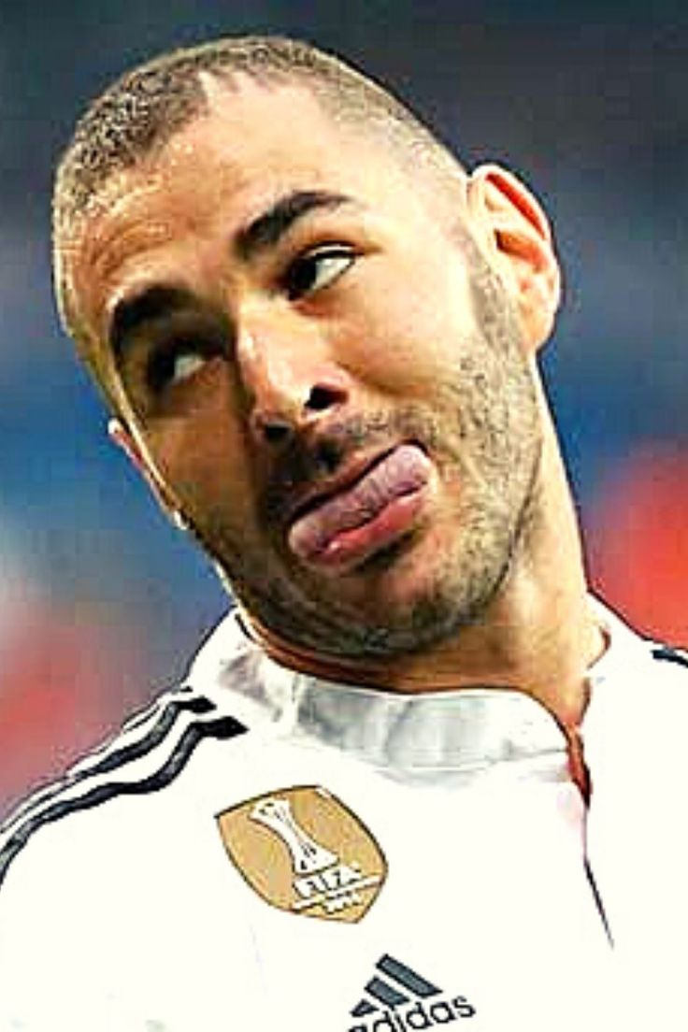
Top Most Paid Players
1
Lionel Messi
2
Kevin De Bruyne
3
Karim Benzema

Slide 9

Which foot do players use most?
75 %
25%
RIGHT-FOOTED
LEFT-FOOTED

Slide 10
Best Passers
Short Pass
K. De Bruyne
Xavi
T.Kroos
Long Pass
T.Kroos
K. De Bruyne
Xabi Alonso
Best Overall Passers
K. De Bruyne
T. Kroos
Lionel Messi

Slide 11
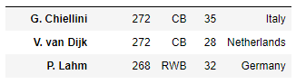
Top Defenders
Details of Defenders
G. Chiellini
Defending Score
Best Position
Age
Name
Nationality
V. van Dijk
P. Lahm

Slide 12
Strongest Players
A. Akinfenwa
O.Onyewu
D.Dike
Fastest Players
(Combination of acceleration and sprint_speed)
Adama Traore
B. Ronhaar
R. Sterling

Slide 13
Model Building
Statistical Analysis
X-y Splits
Trained the model
Build the Linear Model
Checked the accuracy scores
Checked the differences between real and predicted values

Slide 14
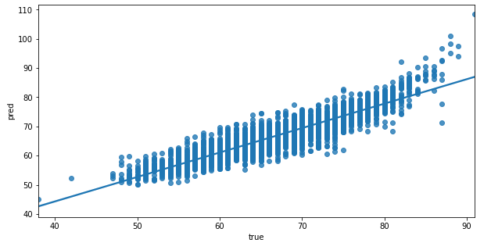
Regression Summary
R2 Score - 0.828
Adjusted R2 - 0.83
MSE - 7.97
MAE - 2.15
RMSE - 2.82
Performance based variables are effective in predicting OVA, with exception of players with extremely high OVA. Gap between true and predicted values for these extreme data points might be explained by non performance based variables.

Slide 15
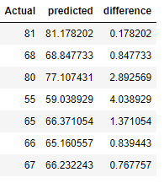
Conclusion
Our feature selection process was effective in predicting the overall value of players.

Slide 16


Thank You

